Slide 1


COVID-19 Data Analysis using Microsoft Power BI
Webinar
July 4 – 10 to 11 AM
Dinesh Kumar P
Technical Product Manager
Syncfusion Software
Notes:
A very good morning to one and all attending this webinar. Especially Gunasundari mam, for providing this opportunity to share my knowledge about Data Analysis.

Slide 2

For what quality, people get different pays for their job?
$ 1,00,000
$ 70,000
$ 50,000
$25,000
Notes:
Let me ask a simple question. For what basic skill, different people get different salary? Perhaps that is the same basic thing which all the Data Analysis projects are solving and make our life easier.

Slide 3



Decision Making
Notes:
Its DECISION MAKING. And that’s what Artificial Intelligence is doing for Humans right?

Slide 4
Every progress in a work Driven by decision making
Programmer decides,
If branch (or)
Switch statement
Business man decides,
More discount (or)
Kind words
Data Analyst decides,
Linear model (or)
Regression model

Slide 5
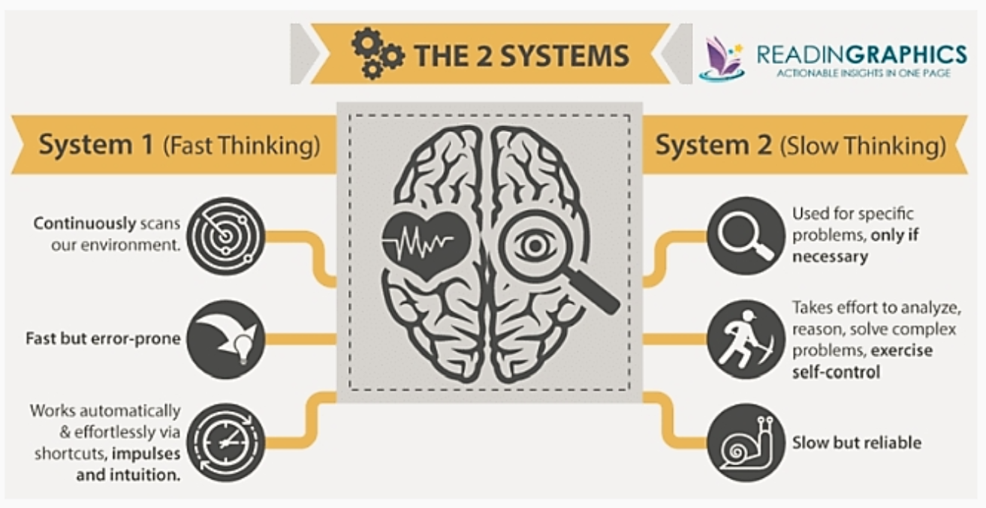
Notes:
Brain has different learning and decision making systems. Same way different Data Analysis techniques helps to take fast and slow decision making systems.

Slide 6
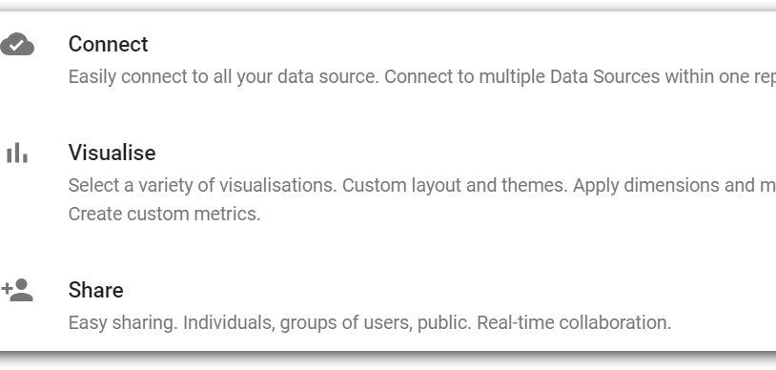
Notes:
Any BI tool will be addressing the following requirements:
It would enable connectivity in different business apps with ease along with security standards maintained during data transfers.
It would allow analyzing those data.
It would allow creating effective visuals easily and should be able to narrate the insights on its own.
The difference between different tools would be like, number of data source connections / number of charts / administrator features like user management / usability / cost factor / embedding and so on.

Slide 7
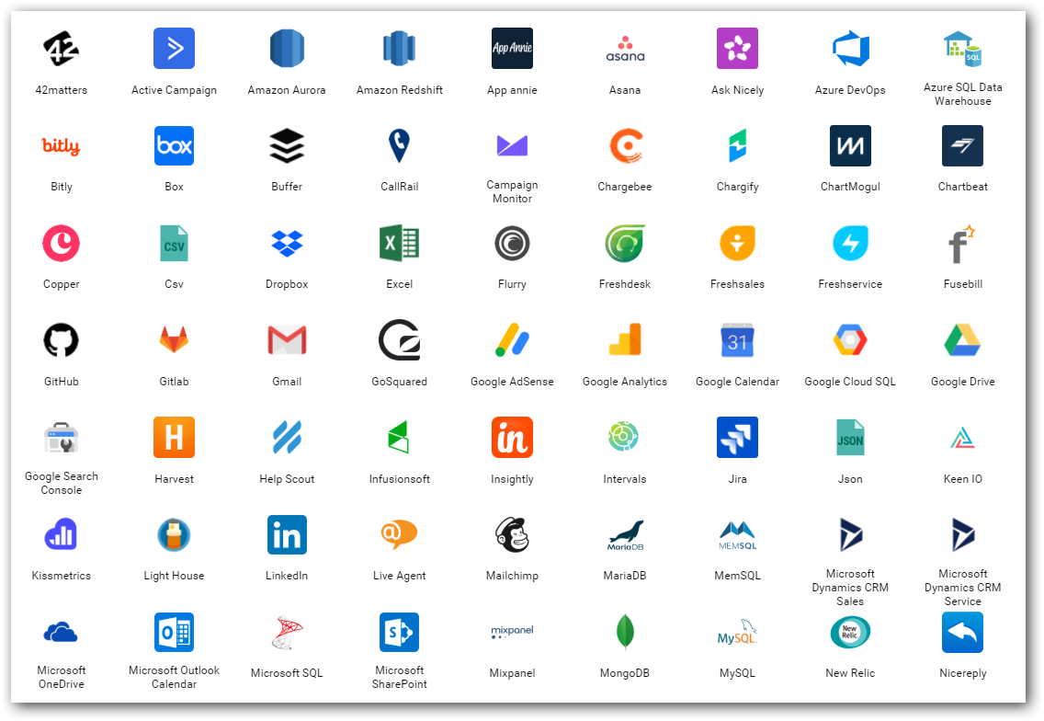
Data source(s)
Find out from where you need to get the data for your project.
Either provided or should search and find.
Logs
Databases
Web (REST APIs)
Social Media
…
Notes:
Logs – NASA logs which we gonna process.

Slide 8
SQL
Excel, Microsoft SQL, MySQL, PostgreSQL…
No(t) SQL
Format - Table with Rows and Columns.
Structured Data - RDBMS
CSV, JSON, AVRO, XML…
Format – Like Table, Parent/child, Nodes and edges…
Semi structured or no structure at all.
Notes:
Any BI tool will support either one of these 2 type of Data.

Slide 9
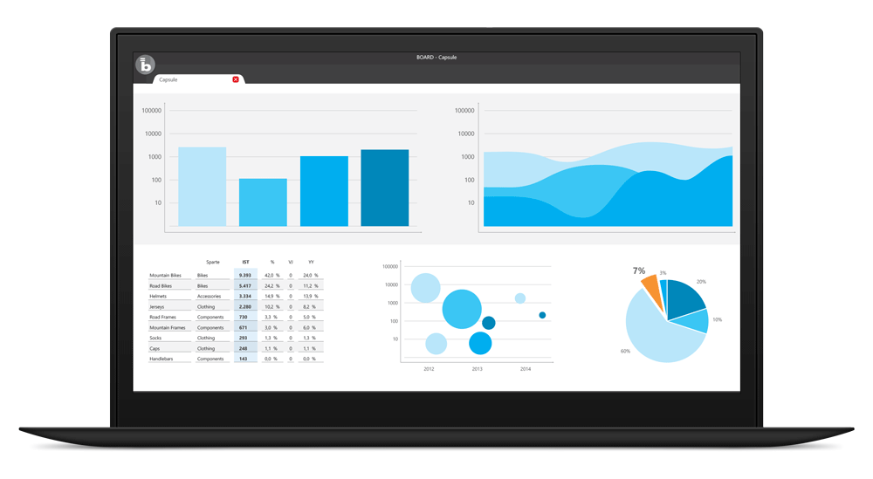
Visualize
BI tools for business decisions,
Microsoft Power BI
Tableau
Qlik
Bold BI
…
In-built packages in R, Python
Notes:
Most important.
This is how the top cream layer gets the view of their business that leads to decisions.

Slide 10
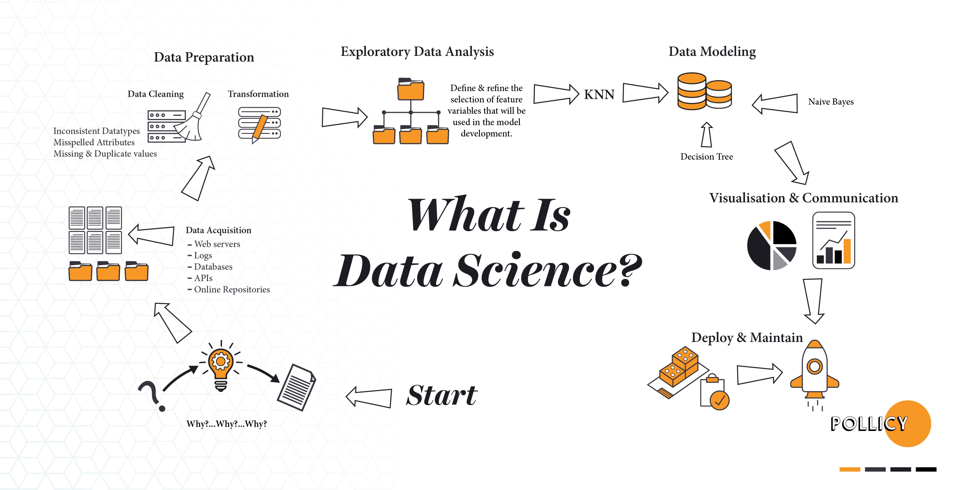
Notes:
I would say out of all, Data Analysis is most important process for a success of any data project being at the middle and playing a major role.

Slide 11
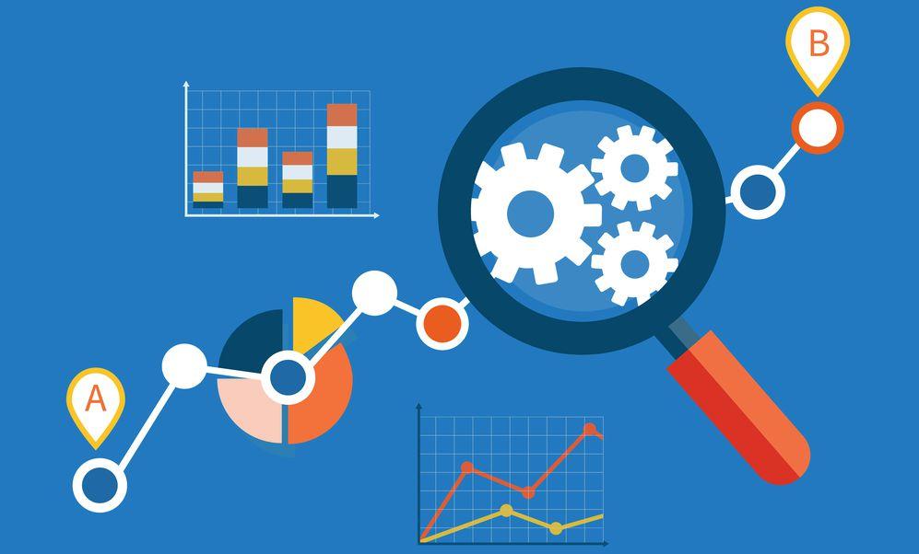
Importance of Data Analysis
How to convey your boss with data in Excel with thousands of rows?
Just convey it as a bar chart / pie chart instead of explaining numbers.
Meaning and purpose to the original data.
See the story that lives in your data.
Discover patterns (HISTORY), metrics (CURRENT) and spot trends (FUTURE).

Slide 12
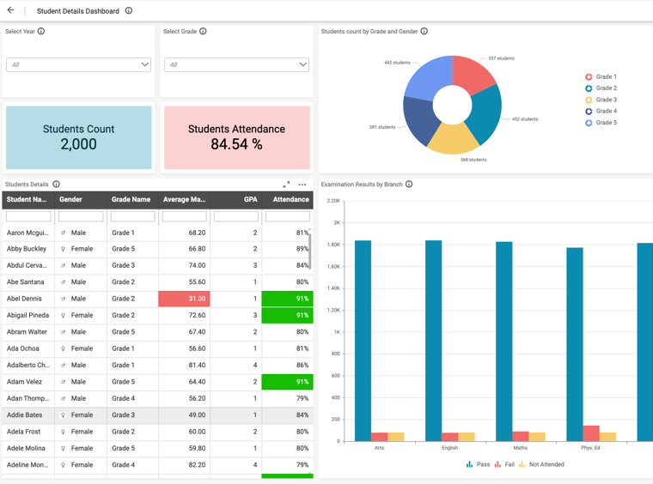
Sharing and Collaboration
User Management - Access control between users for Dashboard / Data source.
E.g. Currently we use.
Row level data security.
E.g. One Student Performance Analysis Dashboard for entire college;
Principal – Can see all departments.
Department head – Can see specific department alone.
Class Tutors – Can see specific class alone.

Slide 13
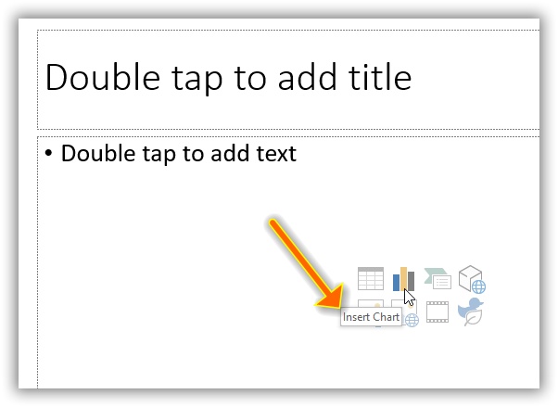
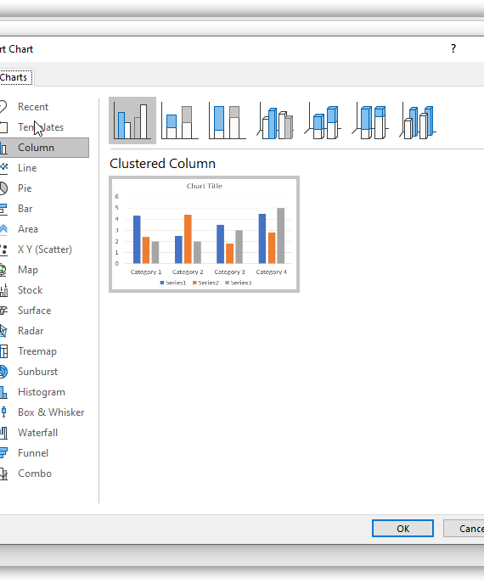
PowerPoint
Notes:
Visuals in PowerPoint. A miniature of Excel and Power BI into PowerPoint itself.

Slide 14
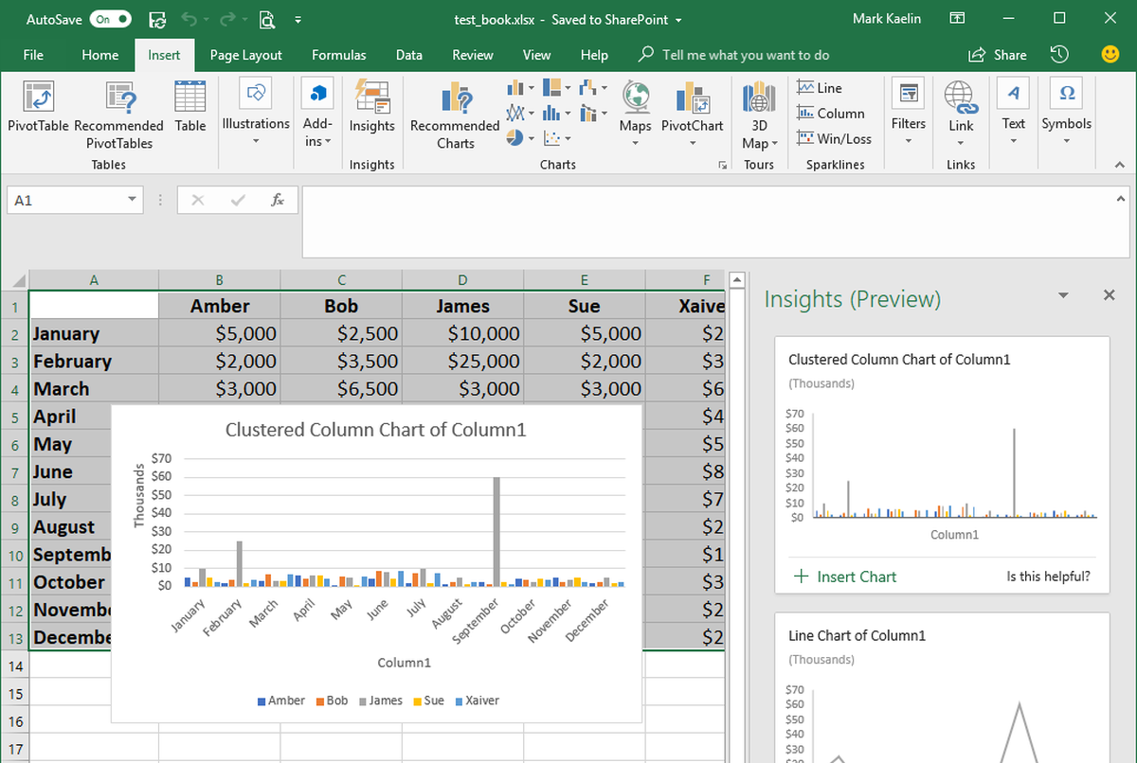
Excel
Notes:
Do we have anyone here know about or using “Ideas” in Excel?
Auto Data Analysis
Quickest and easiest way of Learning data analytics, visualization.
Works only with internet.
Demo
COVID-19 Data as Sheets, Dashboards, Story.
For Outliers – Show Energy Data as example. Excel Ideas also can help for Data Profiling to ensure the correctness of Excel data like there is no incorrect info like Outliers.

Slide 15

Basic things to know for Data Analysis

Slide 16
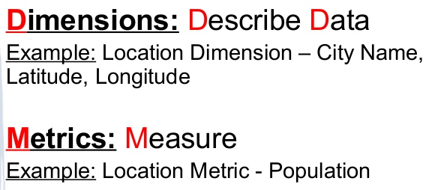
Dimensions vs Measures

Slide 17
Is your Data good enough for Analysis? How do you find out?
Find out by going for a Data Profiling Exercise. Helps you to understand the quality of your data.
Based on the quality, you can make a GO or NO GO decision for the next step – Data Analysis.
Notes:
Can do Data Profiling either manually or via Software such as iData. There are many benefits to be reaped by using software to automate the data profiling process, including: Increased Speed (resulting in hard £/$ savings) Industry estimates for manual data profiling are approximately 3-5 hours per attribute; By using a data profiling tool, this can be reduced to 15-30 minutes.

Slide 18

Three things for effective visualization
Always audience in mind.
Clever in COLORS.
Use more Words.
June 2019
June 2020
Copyright © 2020 Syncfusion, Inc. All rights reserved.
Notes:
As mentioned in the first slide, effectively communicating the extracted insight to the target audience is important. These are 3 simple skills to improve the storytelling with data.
First and foremost is being specific about who your audience is. One should design everything keeping that audience in mind. Creating a chart for a communication purpose for our understanding is an easy task. If we step out of ourselves and think how do, we design for our audience will give effective results. Thinking is nothing but knowing ‘who are they’, ‘what do they care or expect’, ‘what keeps them up at night’.. Designing dashboards, keeping such motivation factors in mind will allow us to get their attention and can get our message across easily.
Next, coming to colors – It is not only about using pleasing colors in a dashboard. Think about where your audience to look and create a sparing contrast to achieve the attention.
Next, we should use more words in a dashboard. I mean it is words not sentences. Like axis labels, value labels, titles in a dashboard. Really these words will give more meaning quickly to the numbers and charts present in a dashboard.
https://visme.co/blog/dos-and-donts-chart-making/
https://infogram.com/blog/color-theory-dos-and-donts-for-data-visualization/

Slide 19
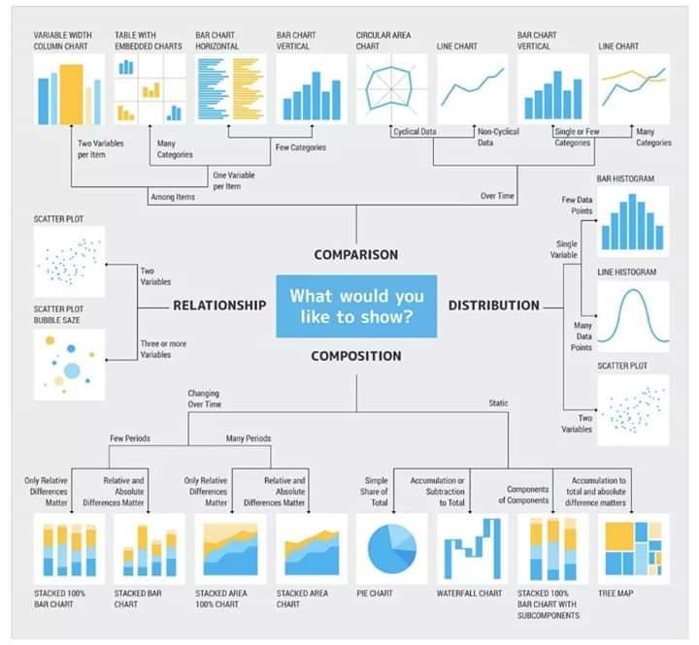
Notes:
This is like a rule book which most of us would be using while we get confused between choosing chart type.

Slide 20
Can you Answer?
Which one of the following is a Measure?
Sales Revenue
Sales Region
Sales Date
Notes:
Measures are numerical values that mathematical functions work on. Which one of the following is a Measure?

Slide 21
Can you Answer?
How do you find out is your data is good enough for Analysis?
Notes:
By exercising Data Profiling

Slide 22
COVID-19 dashboard using Microsoft Power BI
Demo
Notes:
https://app.powerbi.com/groups/me/reports/279cdc82-8a49-487c-b015-21d6eb900de0/ReportSection0e72bac688f60e7252ea?noSignUpCheck=1
Open web power bi. Connect to SQL server own COVID-19 data. Start designing and show the best practices with that.
Finally show already created 2 dashboards and tell the story.

Slide 23
Can you Answer?
What is the new feature in Excel that does automatic data visualization?
Notes:
Ideas

Slide 24
Can you Answer?
Apart from Connect and Visualize, what is the 3rd important thing in a Business Intelligence tool?
Notes:
Share
Collaboration

Slide 25
Opensource tools
Visualization
1. Tableau Public
2. Kibana
Data Profiling
1.

Slide 26

Thank you! Questions ??

